Slide 1
Prompt Engineering Guide
Nneoma Nnorom

Slide 2
Domain Overview
System Prompt Structure
Temperature, Reasoning & Thinking
Structured Output
The RCRF framework which includes: Role, context, rules, format.
low, medium, and high, Chain of thought, thinking blocks, budget_tokens
XML tags, JSON schema, validation + retry loop
Prompt Evaluation
Prompt Engineering Technique
Prompt Caching
options available to do after writing a prompt, evaluation workflow, graders, evaluation criteria
clear and direct, being specific, using structured XML tags, providing examples,
how it works, cache_control, cost model
2 / 12

Slide 3
Anatomy of a Claude API Call
Three components — distinct roles, distinct priority order
① System Prompt
② Human Turn
③ Assistant Prefill
Static · Cached · Highest priority
Variable · Per request · Task-specific
API-only · Format constraint
· Sets role, context, rules, format
· Only what changes per query
· Provide opening characters: { " }
· Applies to every user message
· The user's specific question/task
· Forces response to begin with JSON
· Contradictions: system wins
· Does NOT override system rules
· Claude cannot add preamble text
· Put format instructions HERE
· Do not repeat format instructions
· Most reliable format enforcement
Priority order: System Prompt > Human Turn > Assistant Prefill · System wins all conflicts
3 / 12

Slide 4
System Prompt Design — RCRF Framework
Four components every system prompt must contain
R
Role
"You are a senior billing analyst for a SaaS company."
Who Claude is. Sets tone, expertise, personality.
C
Context
"Users are developers on the Pro plan troubleshooting API errors."
The operating situation — users, system, typical needs.
R
Rules
"Respond only about our API. Escalate unresolved issues after 3 steps."
Explicit constraints. Positive instructions only.
F
Format
"Always return: { \"answer\": string, \"steps\": string[], \"needs_human\": boolean }"
Output schema. Show the exact format — don't describe it.
EXAM TIP Replace every negative rule ('don't use bullets') with a positive alternative ('respond in plain prose paragraphs')
4 / 12

Slide 5
System Prompt
Defines Claude’s permanent behaviour, rules, format, safety boundaries, and operating instructions.
Use system prompts for:
Output format requirements
Tone and behavioural constraints
Safety policies
Role definition
Persistent instructions
For Stable instructions
Example
You are a compliance auditor.
Always return valid JSON.
Never invent missing data.
3 / 12

Slide 6
User Prompt
Contains the task-specific request and dynamic input data.
Use user prompts for:
Questions
Documents to analyse
Temporary instructions
User-specific context
Variable task content
Example
You are a compliance auditor.
Always return valid JSON.
Never invent missing data.
3 / 12

Slide 7
Assistant Prefilling
When you send a conversation to the API where the last message has the "assistant" role, the model treats that content as if it already wrote it, and simply continues from where it left off.
So this:
python
add_user_message(messages, prompt)
add_assistant_message(messages, "```json")
Constructs this conversation:
User: "Generate a dataset..."
Assistant: "```json" ← model continues from here
The model doesn't decide how to respond — it's already mid-response, so it just carries on writing JSON after ```json.
Why it's useful
Without prefilling, the model might respond however it likes:
3 / 12

Slide 8
Temperature
Temperature is a powerful parameter that controls how predictable or creative Claude's responses will be. Understanding how to use it effectively can dramatically improve your AI applications.
When you send Claude a prompt like "What do you think?", it goes through three key steps:
Tokenization - Breaking your input into smaller chunks
Prediction - Calculating probabilities for possible next words
Sampling - Choosing a token based on those probabilities
Temperature is a decimal value between 0 and 1 that directly influences these selection probabilities. It's like adjusting the "creativity dial" on Claude's responses.
3 / 12

Slide 9
Temperature
Low temperature gives a more deterministic output while high temperature produces a more random output.
Low Temperature (0.0 - 0.3) Medium Temperature (0.4 - 0.7) High Temperature (0.8 - 1.0)
Factual responses Summarization Brainstorming
Coding assistance Educational content Creative writing
Data extraction Problem-solving Marketing content
Content moderation Creative writing with constraints Joke generation
3 / 12

Slide 10
Response streaming
Response streaming lets users see text appear chunk by chunk as Claude generates it, creating a much more responsive feel.
In a typical chat setup, your server sends a user message to Claude and waits for the complete response before sending anything back to the client. This creates an awkward delay where users have no feedback that anything is happening.
With streaming enabled, Claude immediately sends back an initial response indicating it has received your request and is starting to generate text. Then you receive a series of events, each containing a small piece of the overall response.
3 / 12

Slide 11
Understanding Stream Events
When you enable streaming, Claude sends back several types of events:
MessageStart - A new message is being sent
ContentBlockStart - Start of a new block containing text, tool use, or other content
ContentBlockDelta - Chunks of the actual generated text
ContentBlockStop - The current content block has been completed
MessageDelta - The current message is complete
MessageStop - End of information about the current message
3 / 12

Slide 12
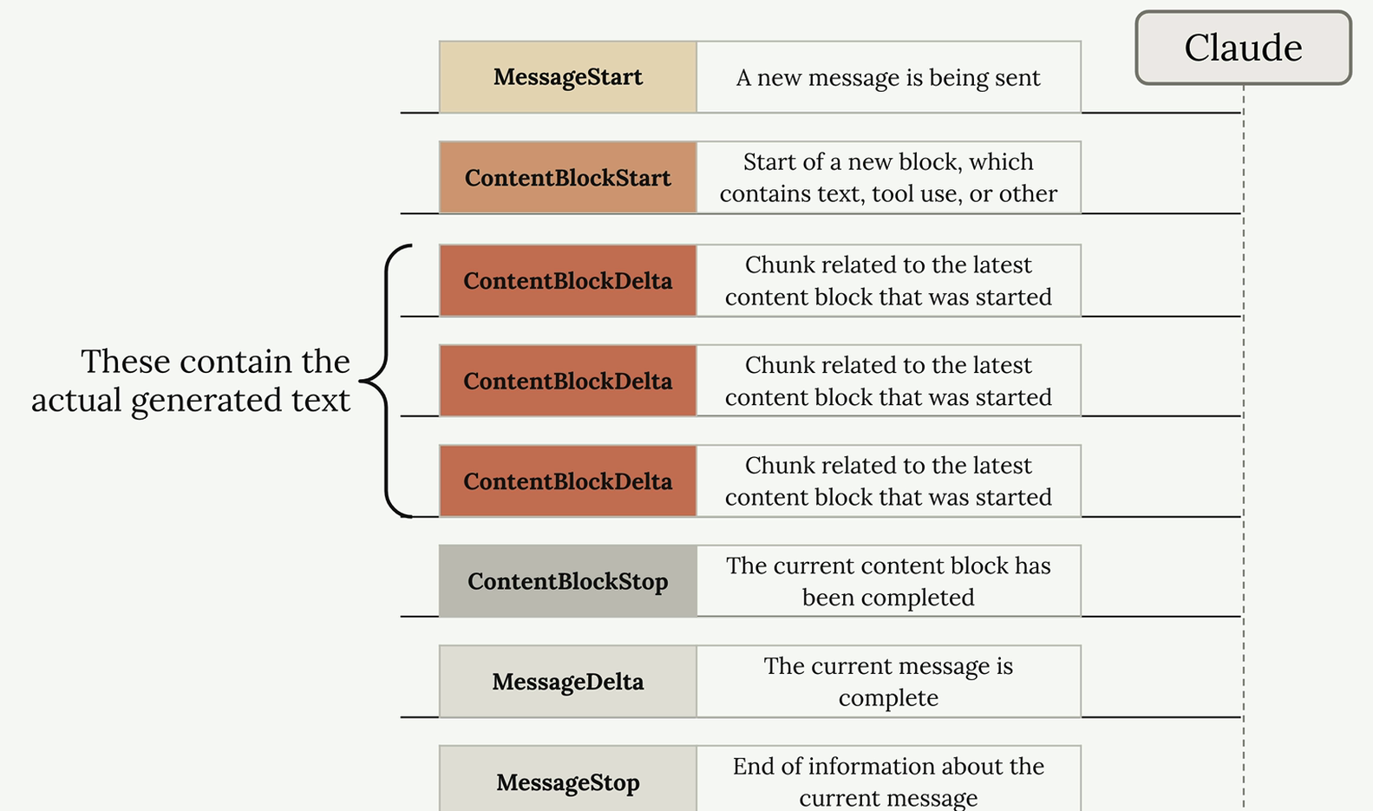
Understanding Stream Events
The ContentBlockDelta events contain the actual generated text that you'll want to display to users.
3 / 12

Slide 13
Structured Data
When you need Claude to generate structured data like JSON, Python code, or bulleted lists, you'll often run into a common problem: Claude wants to be helpful and add explanatory text around your content. While this is usually great, sometimes you need just the raw data with nothing else.
The Solution is Assistant Message Prefilling + Stop Sequences. You can combine assistant message prefilling with stop sequences to get exactly the content you want. Here's how it works:
messages = []
add_user_message(messages, "Generate a very short event bridge rule as json")
add_assistant_message(messages, "```json")
text = chat(messages, stop_sequences=["```"])
3 / 12

Slide 14
Structured Data
This technique works by:
The user message tells Claude what to generate
The prefilled assistant message makes Claude think it already started a markdown code block
Claude continues by writing just the JSON content
When Claude tries to close the code block with ```, the stop sequence immediately ends generation
3 / 12

Slide 15
Prompt Evaluation
Prompt evaluation helps you measure how well those prompts actually work.
Prompt evaluation takes a different approach. Instead of focusing on how to write prompts, it's about measuring their effectiveness through automated testing. You can:
Test against expected answers
Compare different versions of the same prompt
Review outputs for errors
3 / 12

Slide 16
Three Paths After Writing a Prompt
Once you've drafted a prompt, you typically face three options for what to do next:
Option 1: Test the prompt once and decide it's good enough. This carries a significant risk of breaking in production when users provide unexpected inputs.
Option 2: Test the prompt a few times and tweak it to handle a corner case or two. While better than option 1, users will often provide very unexpected outputs that you haven't considered.
Option 3: Run the prompt through an evaluation pipeline to score it, then iterate on the prompt based on objective metrics. This approach requires more work and cost, but gives you much more confidence in your prompt's reliability.
3 / 12

Slide 17
The Evaluation-First Approach
Option 3 represents a more systematic approach to prompt development. By running your prompt through an evaluation pipeline, you get objective metrics about its performance across a broader range of test cases. This data-driven approach lets you:
Identify weaknesses before they become production issues
Compare different prompt versions objectively
Iterate with confidence based on measurable improvements
Build more reliable AI applications
While this approach requires more upfront investment in time and testing infrastructure, it pays dividends in the reliability and robustness of your final application. The goal is to catch problems during development rather than after your users encounter them.
3 / 12

Slide 18
Evaluation Workflow
Step 1: Draft a Prompt: This initial prompt draft serves as the baseline for testing and improvement.
Step 2: Create an Eval Dataset: The evaluation dataset contains sample inputs that represent the types of questions or requests your prompt will handle in production. The dataset should include questions that will be interpolated into your prompt template.
Step 3: Feed Through Claude: Take each question from your dataset and merge it with your prompt template to create complete prompts. Then send each one to Claude to get responses.
Step 4: Feed Through a Grader: The grader evaluates the quality of Claude's responses by examining both the original question and Claude's answer. This step provides objective scoring, typically on a scale from 1 to 10, where 10 represents a perfect answer and lower scores indicate room for improvement.
Step 5: Change Prompt and Repeat: Now that you have a baseline score, you can modify your prompt and run the entire process again to see if your changes improve performance.
3 / 12

Slide 19
Types of Graders
There are three main approaches to grading model outputs:
Code graders - let you implement any programmatic check you can imagine, such as Checking output length, Syntax validation for JSON, Python, or regex, and Readability scores.
Model graders - feed your original output into another API call for evaluation. This approach offers tremendous flexibility for assessing the Response quality, Completeness, Helpfulness, and Safety.
Human graders - Human graders provide the most flexibility but are time-consuming and tedious. They're useful for evaluating: General response quality, Comprehensiveness, Depth, Conciseness, and Relevance.
3 / 12

Slide 20
Defining Evaluation Criteria
Before implementing any grader, you need clear evaluation criteria. For a code generation prompt, you might focus on:
Format - Should return only Python, JSON, or Regex without explanation
Valid Syntax - Produced code should have valid syntax
Task Following - Response should directly address the user's task with accurate code
The first two criteria work well with code graders, while task following is better suited for model graders due to their flexibility.
3 / 12

Slide 21
Prompt Engineering Technique
Prompt engineering is about taking a prompt you've written and improving it to get more reliable, higher-quality outputs. This process involves iterative refinement - starting with a basic prompt, evaluating its performance, then systematically applying engineering techniques to improve it.
The Iterative Improvement Process
The approach follows a clear cycle that you can repeat until you achieve your desired results:
Set a goal - Define what you want your prompt to accomplish
Write an initial prompt - Create a basic first attempt
Evaluate the prompt - Test it against your criteria
Apply prompt engineering techniques - Use specific methods to improve performance
Re-evaluate - Verify that your changes actually improved the results
3 / 12

Slide 22
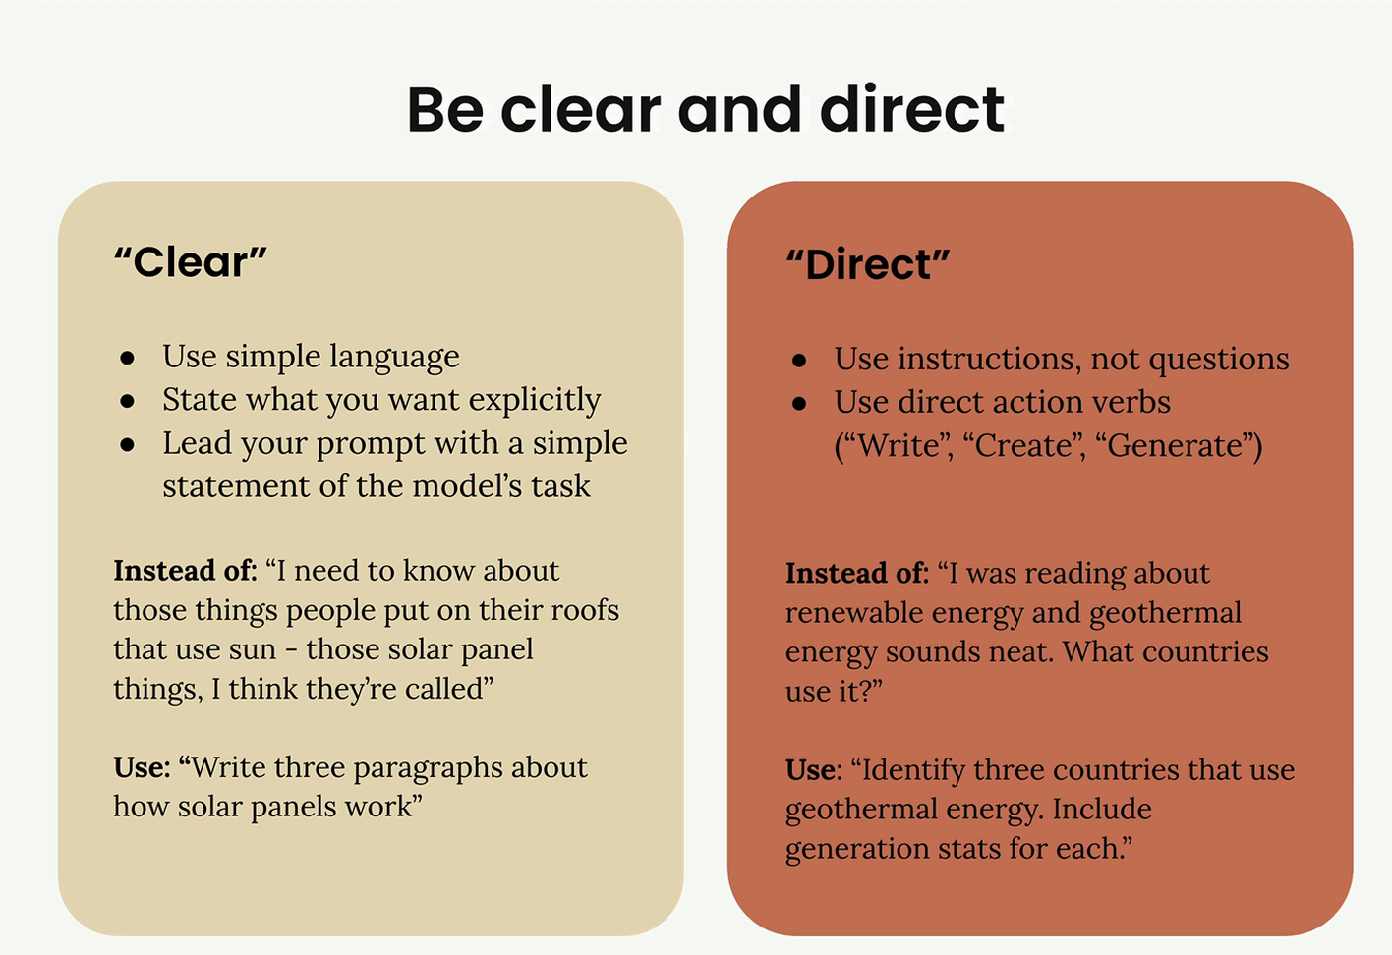
Prompt Engineering Technique
Being Clear and Direct : When crafting that crucial first line, you want to focus on two key principles: clarity and directness. This means using simple language that leaves no room for ambiguity about what you want Claude to do.
3 / 12

Slide 23
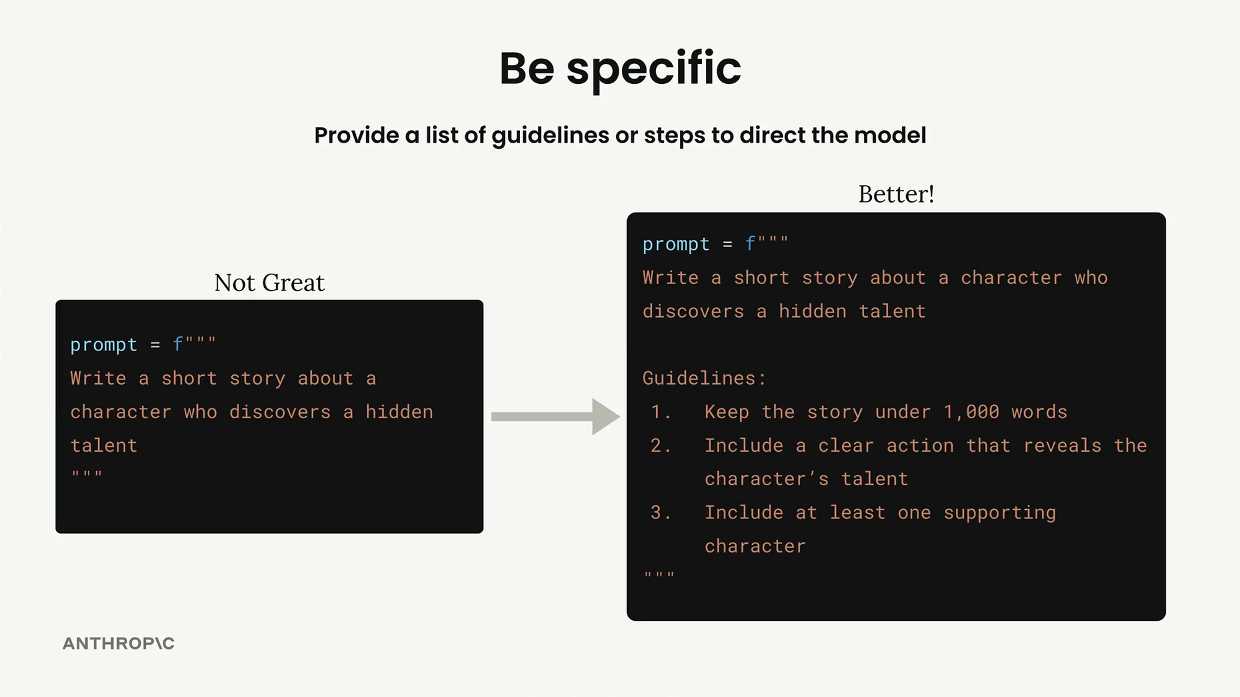
Prompt Engineering Technique
Be Specific: When working with Claude, one of the most effective ways to improve your results is to be specific about what you want. Instead of leaving everything up to the model's interpretation, you can provide clear guidelines or steps that direct Claude toward the kind of output you're looking for.
3 / 12

Slide 24
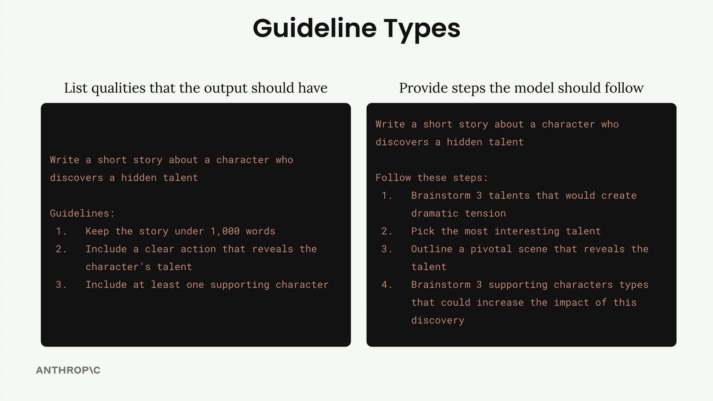
Two Types of Guidelines
Output Quality Guidelines: The first type focuses on listing qualities that your output should have. These guidelines help you control: Length of the response, Structure and format
Process Steps: The second type provides specific steps for Claude to follow. This approach is particularly useful when you want Claude to think through a problem systematically or consider multiple perspectives before arriving at a final answer.
3 / 12

Slide 25
Two Types of Guidelines: When to Use Each Approach
Always Use Output Guidelines: You should include quality guidelines in almost every prompt you write. They're your safety net for getting consistent, useful results.
Use Process Steps For Complex Problems such as Add step-by-step instructions when you're dealing with: Troubleshooting complex problems, Decision-making scenarios, Critical thinking tasks, Any situation where you want Claude to consider multiple angles.
3 / 12

Slide 26
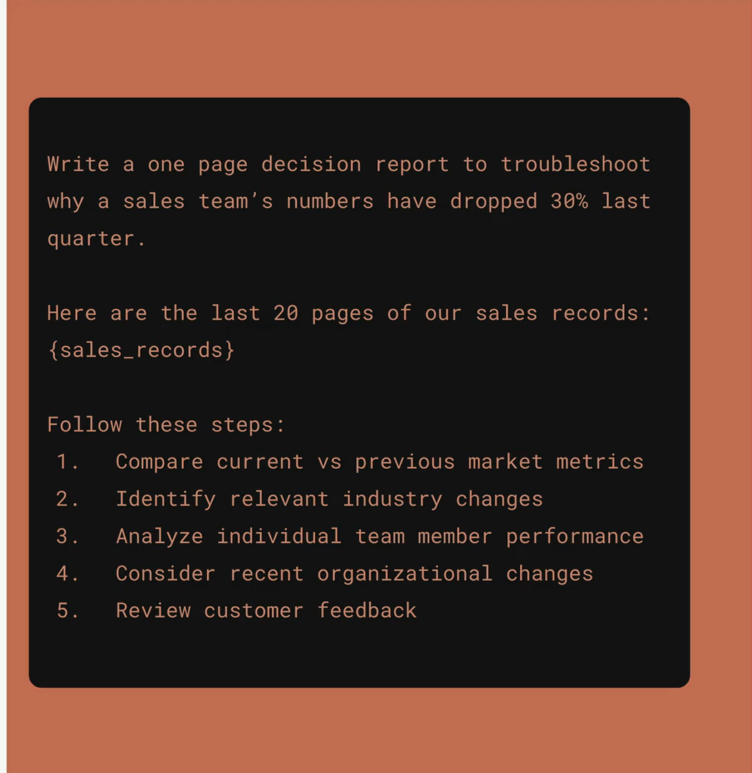
Structure with XML Tag
When you're building prompts that include a lot of content, Claude can sometimes struggle to understand which pieces of text belong together or what different sections are supposed to represent. XML tags provide a simple way to add structure and clarity to your prompts, especially when you're interpolating large amounts of data.
3 / 12

Slide 27
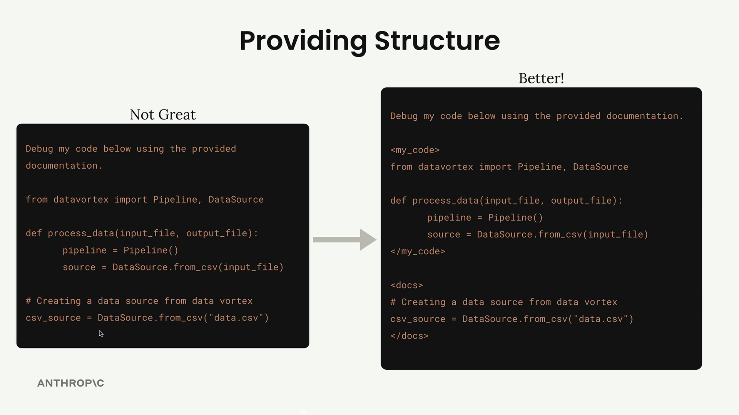
Structured XML Tags
The "Not Great" version makes it nearly impossible to tell what's code versus documentation. The "Better" version uses <my_code> and <docs> tags to create clear boundaries.
3 / 12

Slide 28
Structured XML Tags - Custom Tag Names
You don't need to use official XML tags. Create descriptive names that make sense for your content:
<sales_records> is better than <data>
<athlete_information> clearly identifies user details
<my_code> and <docs> separate different types of content
The more specific and descriptive your tag names, the better Claude can understand the purpose of each section.
3 / 12

Slide 29
Structured XML Tags - When to Use XML Tags
XML tags are most useful when:
Including large amounts of context or data
Mixing different types of content (code, documentation, data)
You want to be extra clear about content boundaries
Working with complex prompts that interpolate multiple variables
Even for shorter content, XML tags can help serve as delimiters that make your prompt structure more obvious to Claude.
3 / 12

Slide 30
Providing Examples
Providing examples in your prompts is one of the most effective prompt engineering techniques you'll use. This approach, known as "one-shot" or "multi-shot" prompting, involves giving Claude sample input/output pairs to guide its responses.
Let's look at a sentiment analysis example. Say you want Claude to categorize whether a tweet is positive or negative:
3 / 12

Slide 31
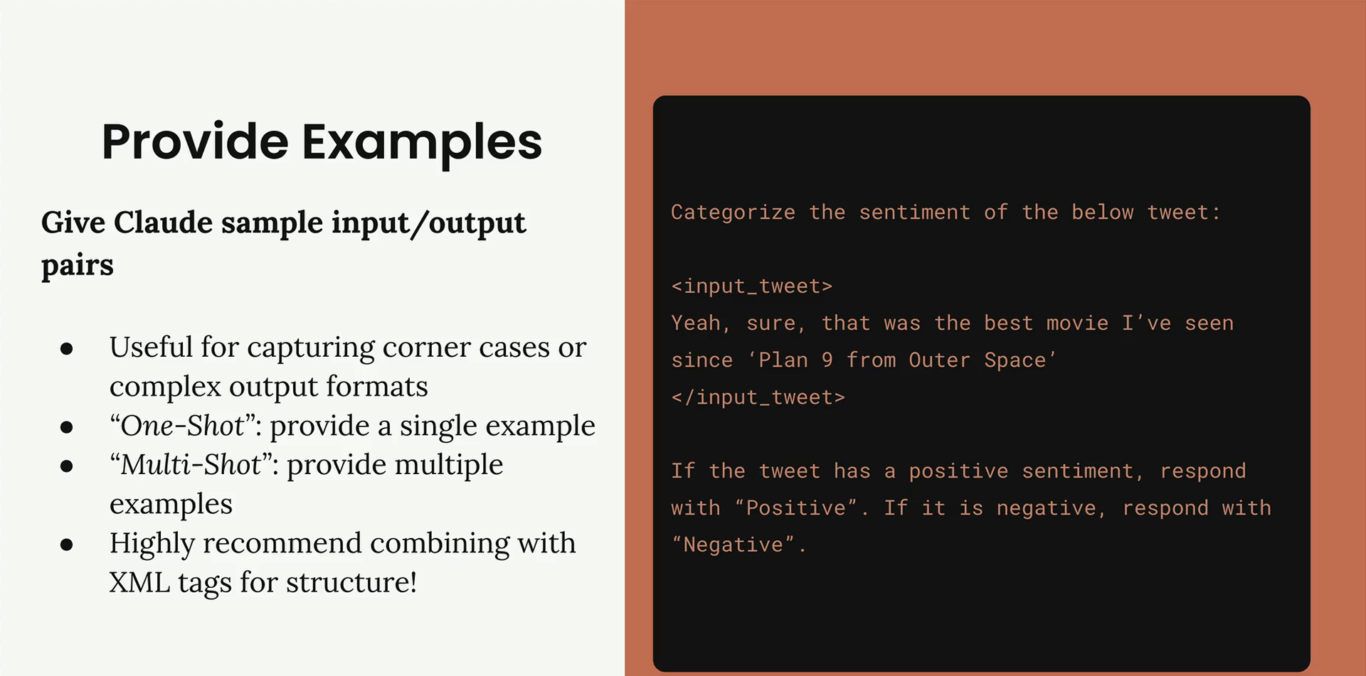
Providing Examples
3 / 12

Slide 32
Providing Examples
Finding Good Examples from Evaluations
When running prompt evaluations, look for your highest-scoring outputs to use as examples. Find responses that scored 10 (or your highest available score) and use those input/output pairs as examples in your prompt. This helps Claude understand what "perfect" output looks like for your specific use case.
Don't just provide the input/output pair - explain why the output is good:
<ideal_output> [Your example output here]
</ideal_output>
This example is well-structured, provides detailed information on food choices and quantities, and aligns with the athlete's
goals and restrictions.
3 / 12

Slide 33
Few-Shot & In-Context Learning
Teaching Claude by demonstration — not by description
Zero-shot
Few-shot 2–5
Many-shot 20+
· Instructions only
✓ Show format + reasoning
· Highly variable inputs
· Simple, well-defined tasks
✓ Optimal for most tasks
· Quality control critical
· Unreliable for format
✓ Best cost-to-quality ratio
· Bad examples hurt performance
Low reliability
★ Recommended
Use with caution
5 Design Principles
1. Format consistency — every example uses identical structure
4. Quality over quantity — 3 perfect examples beat 20 mediocre ones
2. Cover the distribution — span the range of inputs Claude will encounter
5. Place in system prompt — cache them; don't repeat in every user message
3. Include edge cases — show how to handle ambiguous or multi-intent inputs
5 / 12

Slide 34
Prompt Caching — Design & Cost Model
cache_control: ephemeral · Static content costs ~10% on reads
WRITE
READ
SAVE
125%
~10%
~90%
of normal token price on first call
of normal token price on calls 2+
reduction on cached token portion
What to cache
Do NOT cache
✓ System prompt (role, context, rules, format)
✗ User messages
✓ Few-shot examples (3–5 demonstrations)
✗ Conversation history
✓ Long reference documents in system
✗ Dynamic per-request context
✓ Tool definitions in agentic workflows
✗ Session-specific injected data
MINIMUM 1,024 tokens required to cache. Below this the API ignores cache_control. Always check before recommending caching. | Lifetime: 5 minutes (ephemeral)
8 / 12

Slide 35
Prompt Caching
Prompt caching optimizes API usage by allowing you to resume from specific prefixes in your prompts, significantly reducing processing time and costs for repetitive tasks or prompts with consistent elements.
How It Works
When you send a request with caching enabled, the system checks if the prompt prefix up to the cache breakpoint is already cached. If found, it uses the cached version. Otherwise, it processes the full prompt and caches the prefix once the response begins. By default, the cache has a 5-minute lifetime, and it's refreshed at no additional cost each time the cached content is used. A 1-hour cache duration is also available at additional cost.
3 / 12

Slide 36
Two Ways to Enable It
1. Automatic Caching (Simplest)
Add a single cache_control field at the top level of your request. The system automatically applies the cache breakpoint and moves it forward as conversations grow. This is ideal for multi-turn chats.
pythonresponse = client.messages.create(
model="claude-sonnet-4-6",
max_tokens=1024,
cache_control={"type": "ephemeral"}, # ← top-level, automatic
system="You are an AI assistant...",
messages=[{"role": "user", "content": "Your question here"}]
)
3 / 12

Slide 37
Two Ways to Enable It
2. Explicit Cache Breakpoints (Fine-grained control)
Place cache_control directly on individual content blocks to control exactly what gets cached. Everything before the tagged block gets cached; everything after stays dynamic.
response = client.messages.create(
model="claude-sonnet-4-6",
max_tokens=1024,
system=[
{
"type": "text",
"text": "You are an AI assistant analyzing literary works."
},
{
"type": "text",
"text": "<entire contents of a long document>",
"cache_control": {"type": "ephemeral"} # ← cache breakpoint here
}
],
messages=[{"role": "user", "content": "Analyze the themes."}]
)
3 / 12

Slide 38
Top 5 Pitfalls — Recognise & Fix
Common failure patterns the exam tests
01
Vague instructions without examples
FIX: Replace every description with a concrete few-shot example showing the exact expected output.
02
Negative rules without positive alternatives
FIX: For every 'don't do X' write 'instead, do Y'. Negative rules create ambiguity.
03
Trusting a single API call for structured output
FIX: Parse → validate every field → retry on failure (max 3×). A prompt is a request, not a guarantee.
04
No edge-case testing before launch
FIX: Build a 10-case test suite: empty input, all-caps rage, multi-intent, injection, non-English, emoji-only.
05
Failing to cache static content
FIX: Any system prompt + examples over 1,024 tokens must use cache_control. Uncached = paying full price every call.
11 / 12

